Slide 1
Date: April,9
Theme: Safety tips for teens.
English
Grade: 6

Slide 2
The aims of the lesson:
The students will learn about safety differences.
They can do answers the questions.
They can discuss about safety.
They will learn new words.

Slide 3
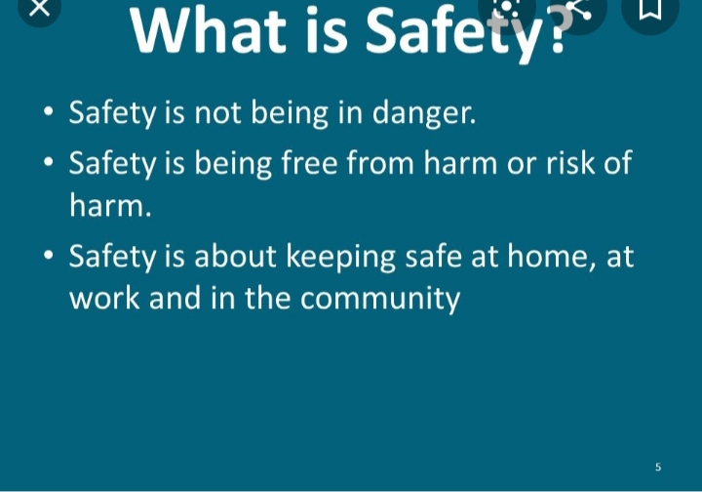
What is safety?

Slide 4
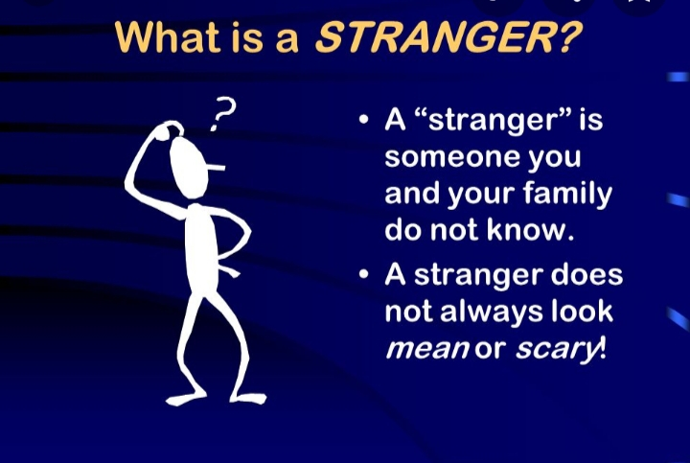
What is stranger?

Slide 5
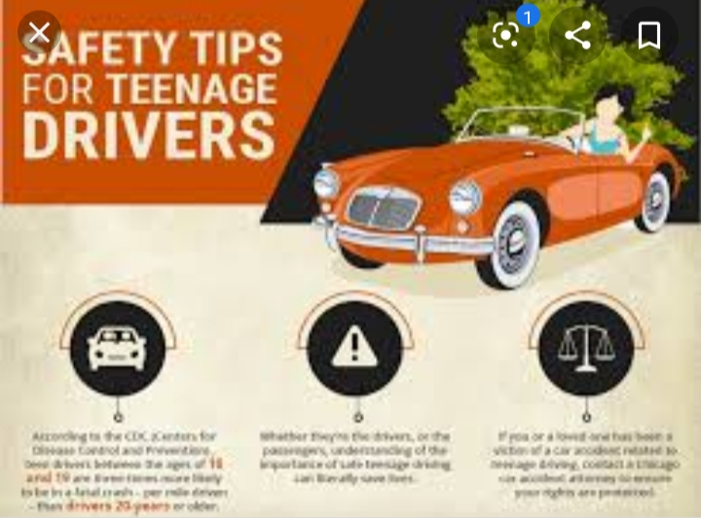
Safety differences.

Slide 6

Safety rules at school.

Slide 7
Work with a partner and answer the questions.
What is safety?
Who is a stranger?
Who are safe strangers?

Slide 8
Remember new words.
Safe -коопсуз
Silent - тынч
Follow - колдоо
Adult – чон киши
Bully- тартипсиз
Safety – коопсуздук
Firefighter – орт очургуч
lock- кулпуга бекитуу
Threaten – коркутуу
Stranger – бейтааныш
Weapon- украл

Slide 9
Conclusion of the lesson.
What kind of new words do you know?
What kind of differences safety do you know?
Have you any questions?

Slide 10
Home work.
Ex.7 a) p.222 write down the tips for safety at home when you’re at home alone. Use the ideas from the box.

